Slide 1
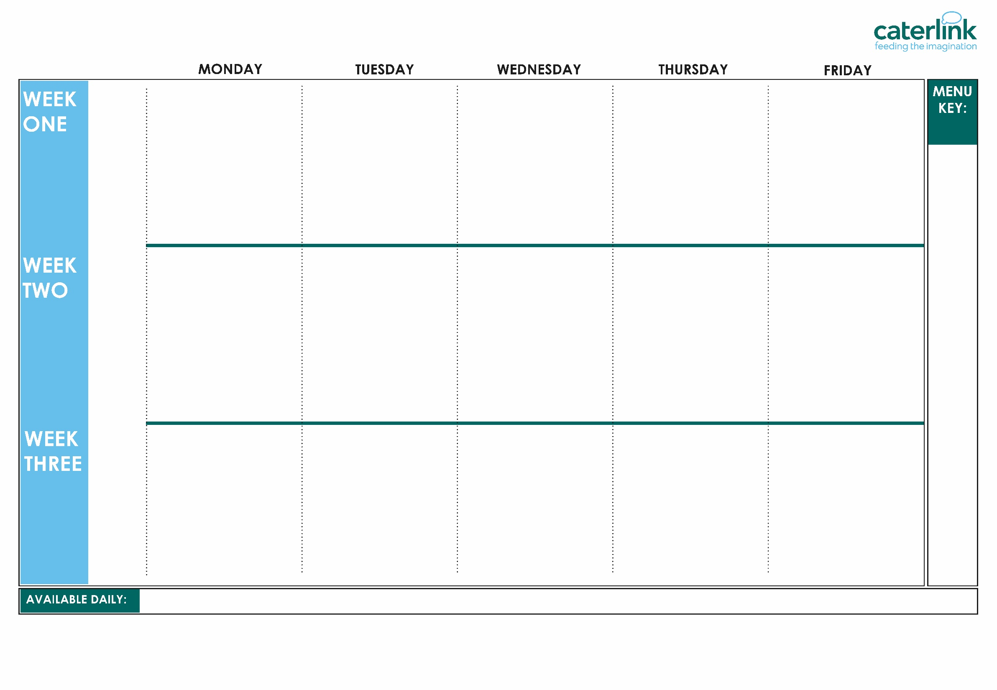
AUTUMN WINTER MENU 2026 / 2027
Rainbow Pizza with seasoned wedges | Halal Meatballs in Tomato Sauce with Rice | Halal Lasagne with Garlic Bread | Halal Chicken Korma curry with Rice | Fish Fingers or Salmon Fish Fingers with Chips and Tomato Sauce
Cheese pin wheel with Weges (V) | Plant Balls in Tomato Sauce with Rice (VE) | Vegetarian mince Lasagne (V) | Quorn and Lentil Tikka Masala with Rice (VE) | Cheese and Bean Pasty with Chips and Tomato Sauce (V)
Vegetables of the Day (V/VE) | Vegetables of the Day (V/VE) | Vegetables of the Day (V/VE) | Vegetables of the Day (V/VE) | Vegetables of the Day (V/VE)
Cheese and Crackers (V) | Apple Cake with Custard (V) | Fruit Medley (VE) | Jelly with Mandarins (VE) | Syrup Sponge with Custard (V)
Option
One
Option
Two
Sides
Dessert
Whole
grain
Cheese & Tomato pizza with Wedges | Halal Spaghetti Bolognaise | Halal Greek Pastitsio Lemon and Herb Quorn, Seasoned Potatoes and Sweetcorn Salsa (VE) | Halal Chicken Tikka Masala with Rice (V) | Breaded Fish or Fish Fingers with Chips and Tomato Sauce
Five Bean Chilli with Rice (VE) | Vegan Bolognaise with Spaghetti (VE) |  | Creamy Chickpea and Coconut Curry with Rice (VE) | Cheese Whirl with Chips and Tomato Sauce (V)
Vegetables of the Day (V/VE) | Vegetables of the Day (V/VE) | Vegetables of the Day (V/VE) | Vegetables of the Day (V/VE) | Vegetables of the Day (V/VE)
Gingerbread Cookie (VE) | Chocolate Brownie with Chocolate Sauce (V) | Fruit Salad (VE) | Sticky Toffee Apple Crumble with Custard (V) | Vanilla Shortbread (VE)
Option
One
Option
Two
Sides
Dessert
Plant
based
Added plant protein
Option
One
Option
Two
Sides
Dessert
Cheese & Tomato pizza with wedges (V) | Halal Chicken Enchilada Bake with Paprika Wedges | Halal Sausage & Mash topped with Gravy | Classic Macaroni Cheese with Garlic Bread (V) Caribbean Stew with Golden Rice (VE) | Fish Fingers with Chips and Tomato Sauce
Mexican Bean Roll with New Potatoes (VE) | Tomato Pasta (VE) | Vegan Sausage & Mash with Gravy (VE) |  | Red Pepper Frittata with Chips & Tomato Sauce
 |  |  |  | Red Pepper Omelette with Chips and Tomato Sauce (V)
Vegetables of the Day (V/VE) | Vegetables of the Day (V/VE) | Vegetables of the Day (V/VE) | Vegetables of the Day (V/VE) | Vegetables of the Day (V/VE)
Oaty Cookie (VE) | Pear Crumble with Custard (V) | Fruit Salad (VE) | Jamaican Ginger Cake with Custard (V) | Iced Sponge (V)
(VE)
Vegan
(V)
Veggie
Jacket Potatoes with a choice of fillings, Salad Bar, Freshly Baked Bread, Fresh Fruit, Yoghurt
If you would like to know about particular allergens in foods, please ask a member of the catering team for information. If your child has a school lunch and has a food allergy or intolerance you will be asked to complete a form to ensure we have the necessary information to cater for your child. We use a large variety of ingredients in the preparation of our meals and due to the nature of our kitchens it is not possible to completely remove the risk of allergen cross contact.

